Slide 1
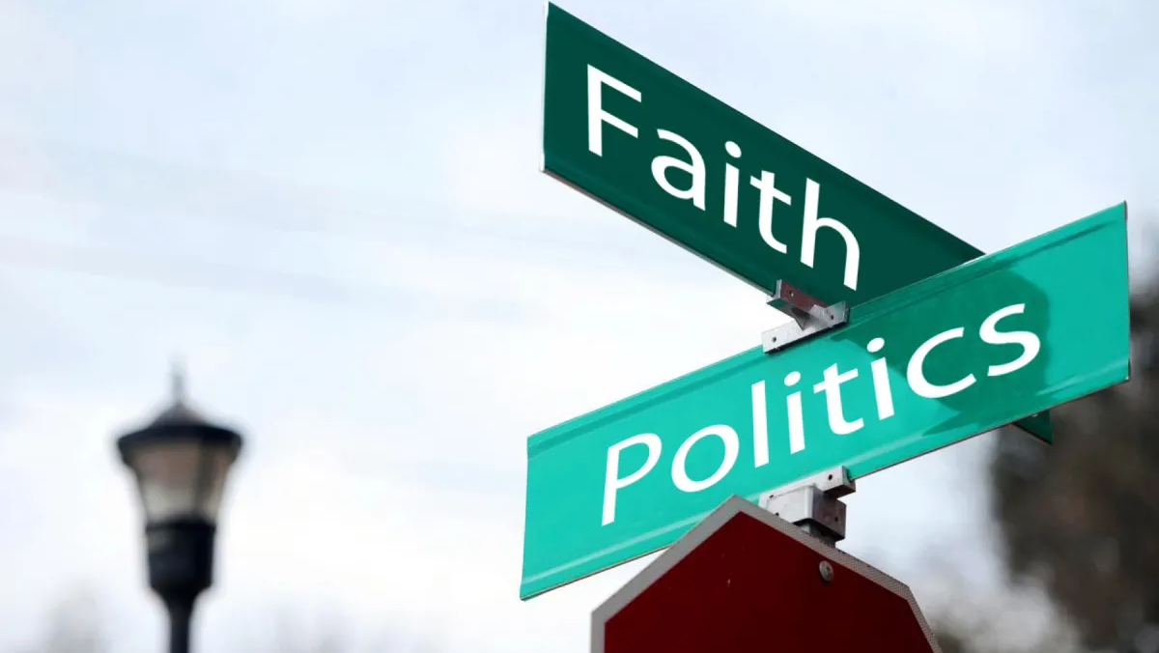
The Christian and Elections
October 13, 2024

Slide 2
The Christian and Elections
Do we have a Christian responsibility to vote?
Believers are expected to exert a godly influence in the culture (Matthew 5:13-16)
13 You are the salt of the earth; but if the salt has become tasteless, how can it be made salty again? It is no longer good for anything, except to be thrown out and trampled under foot by men. 14 You are the light of the world. A city set on a hill cannot be hidden; 15 nor does anyone light a lamp and put it under a basket, but on the lampstand, and it gives light to all who are in the house. 16 Let your light shine before men in such a way that they may see your good works, and glorify your Father who is in heaven.

Slide 3
The Christian and Elections
Do we have a Christian responsibility to vote?
Believers are expected to exert a godly influence in the culture (Matthew 5:13-16)
Believers are expected to pray for our leaders (1 Timothy 2:1-2)
1 First of all, then, I urge that entreaties and prayers, petitions and thanksgivings, be made on behalf of all men, 2 for kings and all who are in authority, so that we may lead a tranquil and quiet life in all godliness and dignity.

Slide 4
The Christian and Elections
Do we have a Christian responsibility to vote?
Believers are expected to exert a godly influence in the culture (Matthew 5:13-16)
Believers are expected to pray for our leaders (1 Timothy 2:1-2)
Believers share the responsibility of government (Romans 13:1-5)

Slide 5
Romans 13:1-5
1 Every person is to be in subjection to the governing authorities. For there is no authority except from God, and those which exist are established by God. 2 Therefore whoever resists authority has opposed the ordinance of God; and they who have opposed will receive condemnation upon themselves. 3 For rulers are not a cause of fear for good behavior, but for evil. Do you want to have no fear of authority? Do what is good and you will have praise from the same; 4 for it is a minister of God to you for good. But if you do what is evil, be afraid; for it does not bear the sword for nothing; for it is a minister of God, an avenger who brings wrath on the one who practices evil. 5 Therefore it is necessary to be in subjection, not only because of wrath, but also for conscience' sake.

Slide 6
Preamble of the Constitution of the USA
We the People of the United States, in Order to form a more perfect Union, establish Justice, ensure domestic Tranquility, provide for the common defense, promote the general Welfare, and secure the Blessings of Liberty to ourselves and our Posterity, do ordain and establish this Constitution for the United States of America.

Slide 7
Lincoln’s Gettysburg address (1863)
“government of the people, by the people, for the people.”

Slide 8
Preamble of the Constitution of the USA
“…in some cultures (like the ancient Roman, in which the New Testament was written) there is not much that Christians can do, other than pray, to influence political structures and policies. But when they can influence them, they should. In modern democracies, all citizens are ‘lesser magistrates’ by virtue of the ballot box. Christians have an obligation to vote according to God’s standards. And, as they are gifted and called, they should influence others to vote in the same way.” (John Frame; The Doctrine of the Christian Life, p. 617).

Slide 9
The Christian and Elections
Do we have a Christian responsibility to vote?
How are we to vote?

Slide 10
Well-Know “Evangelical” Pastor
Never Trump. This year Harris. Always Jesus

Slide 11
Thoughts about Christians and Elections
The Democratic Party is a demonic death cult under the power and influence of Satan.
Believers have a responsibility and privilege to vote for the option that best stems the tide of evil.
Our hope is not in a political party or who is in the White House.
We have every right and expectation to speak out against the evil of our day, but we must not see those against whose policies we rail as our enemies for they are, in fact, our mission field.

Slide 12
Titus 3:3; 4
For we ourselves also once were foolish, disobedient, deceived, enslaved to various lusts and pleasures, spending our lives in malice and envy, despicable, hating one another.
But when the kindness and affection of God our Savior appeared, He saved us, not by works which we did in righteousness, but according to His mercy…

Slide 13
Thoughts about Christians and Elections
The Democratic Party is a demonic death cult under the power and influence of Satan.
Believers have a responsibility and privilege to vote for the option that best stems the tide of evil.
Our hope is not in a political party or who is in the White House.
We have every right and expectation to speak out against the evil of our day…
Are we more likely to promote our political views than we are to proclaim Jesus Christ?

Slide 14
Psalm 20:7
Some boast in chariots and some in horses,
But we will boast
in the name of the LORD, our God.

Slide 15
The Christian and Elections
October 13, 2024

